Slide 1

Robots in Space: A Journey of Exploration and Discovery
By IU5-32B Students:
Podgornova Karina
Kudabaeva Evita

Slide 2
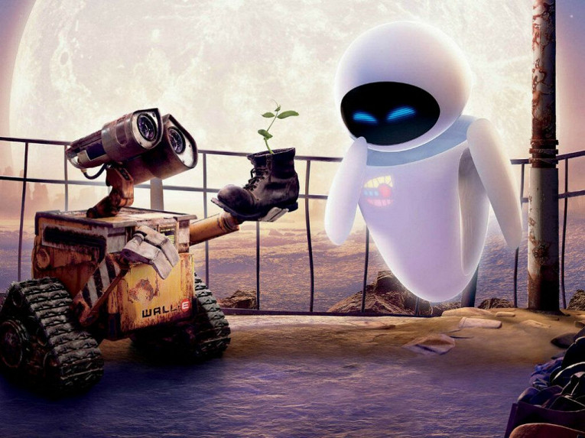
Contents of the presentation
Introduction to Space Robotics
History and First Space Robots
Working Mechanisms and Structure
Types of Space Robots with Examples
Development and Comparison
Milestones and Contributions
Future Development
Thoughts and Opinions
- Conclusion

Slide 3
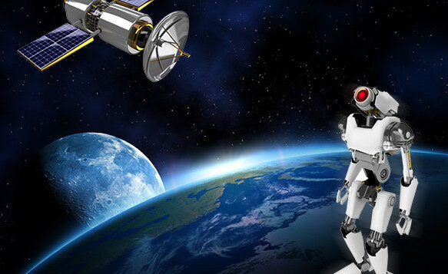
Defining Space Robotics
A space robot is a robotic system designed to operate in the vacuum, extreme temperatures, and radiation-filled environment of outer space.
These machines are our mechanical proxies, performing tasks that are too dangerous, difficult, or repetitive for human astronauts, extending our reach and knowledge of the cosmos.

Slide 4
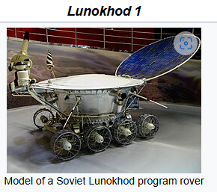
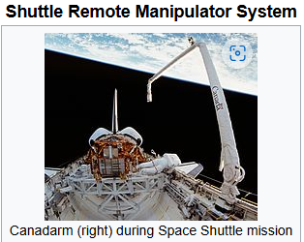
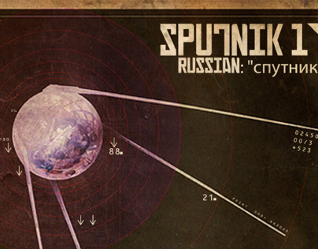
Early Attempts at Space Robotics:
Early Mechanical Aids (1950s-1960s):
Soviet Sputnik 1 (1957) used a basic mechanical system to deploy its antennas.
The First True Space Robot: Lunokhod 1 (1970):
The Soviet Union launched Lunokhod 1 on November 17, 1970, aboard the Luna 17 spacecraft. It landed in the Mare Imbrium region of the Moon.
Early Robotic Arms (1980s):
The Space Shuttle program saw the introduction of robotic arms like the Remote Manipulator System (RMS), also known as the Canadarm.

Slide 5
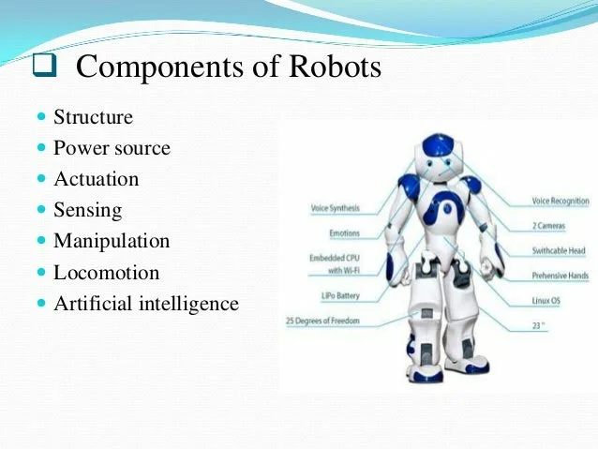
Structure and Working Mechanisms
Locomotion:
This varies depending on the robot's purpose.
Manipulators:
Robotic arms and grippers allow robots to interact with their environment, handle tools, and collect samples.
Power Source:
Solar panels are common for missions near the Sun.
Sensors:
Cameras, spectrometers, radiation detectors, and other instruments gather data about the environment.
Communication System:
Antennas and transponders allow robots to communicate with Earth or other spacecraft.
Control System:
Onboard computers manage the robot's operations, either autonomously or through remote control.
1
2
3
4
5
6

Slide 6
Landmark Developments in Space Robotics:
The Mars Exploration Rovers
1
The Mars Exploration Rovers, Spirit and Opportunity, made groundbreaking discoveries about the Martian environment.
The Curiosity Rover
2
Curiosity, a more advanced rover, has explored Gale Crater and provided evidence for past water activity on Mars.
The Perseverance Rover
3
Perseverance is a more advanced rover that is currently exploring Mars, searching for signs of past life.

Slide 7
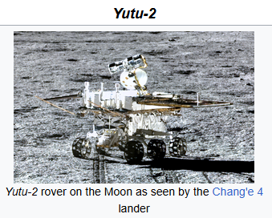
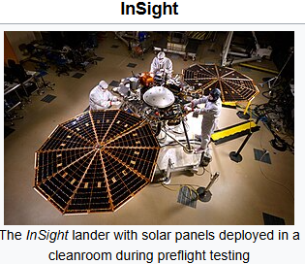
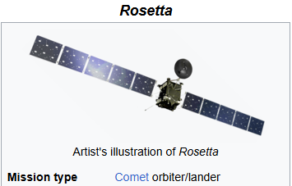
Types of Space Robots
Rovers
Landers
Orbiters
Mobile robots designed to explore planetary surfaces, such as Mars rovers like Curiosity and Perseverance.
Spacecraft designed to land on a planetary surface and conduct scientific experiments, such as the Viking landers on Mars.
Spacecraft that orbit a planet or moon and collect data from a distance, such as the Rosetta.

Slide 8
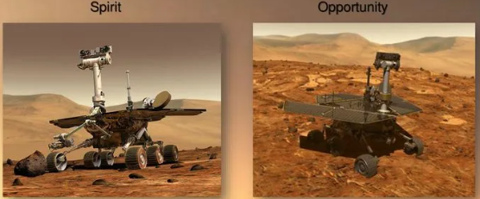
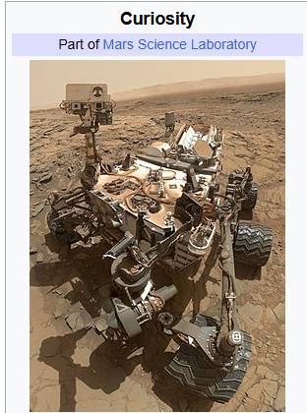
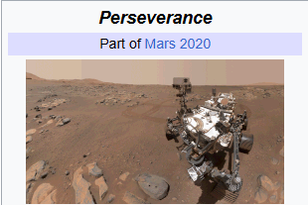
Evolution of Space Robotics
1
The Dawn of Automation (1950s-1970s):
Simple mechanical devices and remotely controlled rovers like Lunokhod 1.
The Era of Robotic Arms (1980s-1990s):
Introduction of robotic arms like the Canadarm on the Space Shuttle.
The Rise of Autonomous Rovers (2000s):
Development of more sophisticated sensors and onboard computers.
Examples include the Mars Exploration Rovers (Spirit and Opportunity)
The Age of Advanced Robotics (2010s-Present):
Highly capable rovers with advanced scientific instruments, robotic arms with greater dexterity, and the use of AI for decision-making.
Examples include Curiosity and Perseverance on Mars.
2
3
4

Slide 9
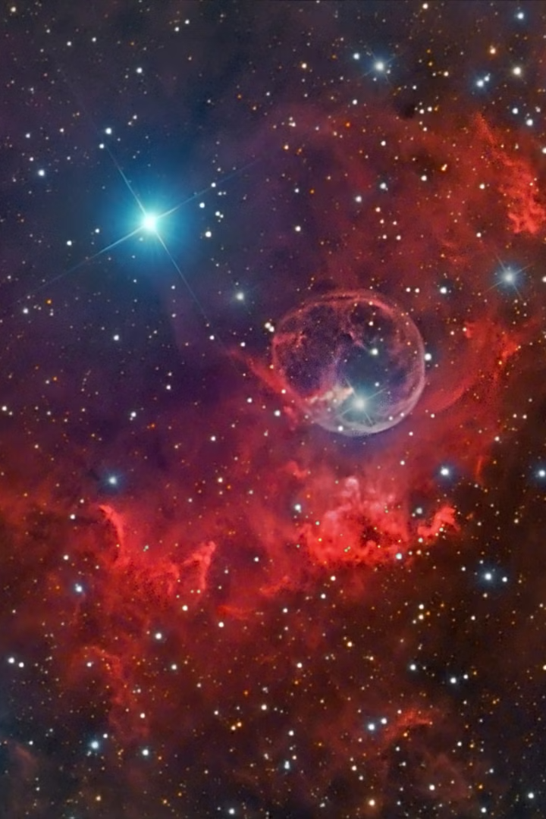
Contributions of Space Robots to Humanity and Science: Expanding Our Knowledge of the Universe
Scientific Discoveries
Technological Advancements
Space robots have made groundbreaking discoveries about the planets, moons, and other celestial bodies in our solar system.
Space robotics has driven advancements in fields like robotics, computer science, and materials science.
Inspiration for Future Generations
The success of space robots has inspired generations of scientists, engineers, and dreamers.

Slide 10
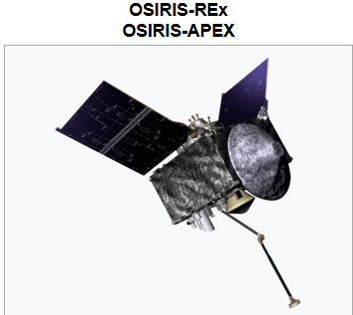
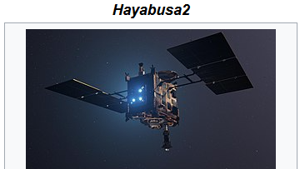
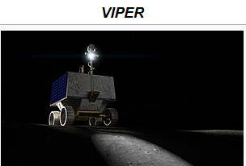

Slide 11




Prognosis for the Future of Space Robotics: A Bright Future Awaits
Advanced Robots
Future space robots are expected to be more autonomous, intelligent, and capable of performing more complex tasks.
New Frontiers
Space robots will play a crucial role in exploring distant planets, moons, and asteroids, expanding our knowledge of the universe.
Space Infrastructure
Robots will be used to build and maintain space infrastructure, such as space stations and lunar bases.

Slide 12

Conclusion: The Enduring Impact of Robots in Space
Space robots have revolutionized space exploration, pushing the boundaries of our understanding and enabling us to reach new heights in our quest to unravel the mysteries of the space.

Slide 13

Thank you for your attention!

